Slide 1



Introduction to Website Investigation with Burp Suite
Burp Suite is a powerful web application security testing tool that allows you to intercept, analyze, and manipulate web traffic to identify vulnerabilities in websites. This introduction will guide you through the key features and capabilities of Burp Suite.

Slide 2

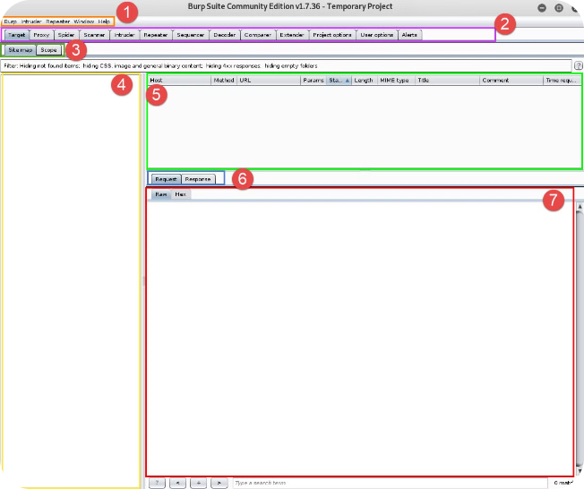
Understanding the Burp Suite Interface
1
Proxy
Intercepts and inspects all web traffic passing through the user's browser.
2
Spider
Crawls the target website to discover hidden content and pages.
3
Scanner
Automatically scans the website for common vulnerabilities.
4
Intruder
Automates and personalizes attacks to find security weaknesses.

Slide 3

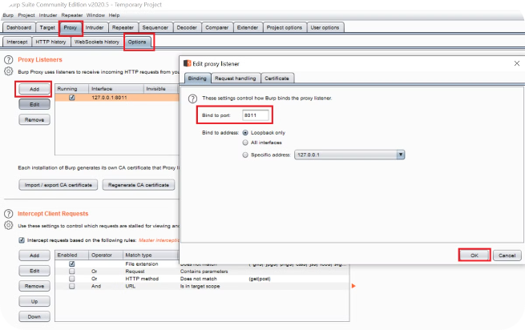
Intercepting and Analyzing Web Traffic
1
Capture
Burp Suite captures all HTTP and HTTPS requests and responses between the user's browser and the target website.
2
Inspect
The captured traffic can be inspected, edited, and replayed to understand the website's functionality and behavior.
3
Modify
Burp Suite allows you to modify requests and responses in real-time, enabling advanced testing and exploitation techniques.

Slide 4
Identifying Vulnerabilities with Burp Suite
Automated Scanning
Manual Testing
Vulnerability Identification
Burp's Scanner module can automatically identify a wide range of vulnerabilities, including SQL injection, cross-site scripting, and more.
Burp Suite also provides advanced manual testing capabilities, allowing you to craft custom attacks and explore the website's attack surface.
The tool highlights discovered vulnerabilities and provides detailed information to help you understand and exploit them.

Slide 5
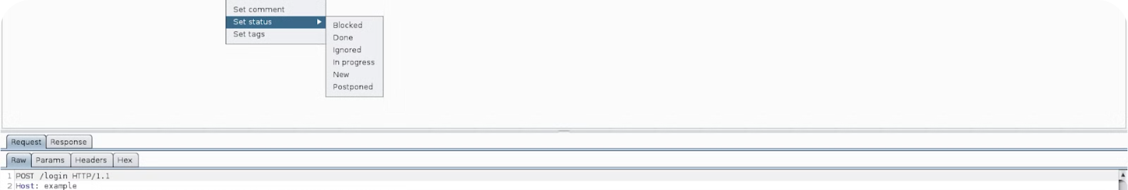
Performing Vulnerability Assessments
Scope Definition
Information Gathering
Clearly define the targets and objectives of the assessment to ensure comprehensive coverage.
Gather detailed information about the target website, including its technologies, architecture, and attack surface.
Vulnerability Discovery
Risk Analysis
Utilize Burp Suite's advanced features to thoroughly investigate the website and uncover vulnerabilities.
Assess the potential impact and exploitability of identified vulnerabilities to prioritize remediation efforts.

Slide 6


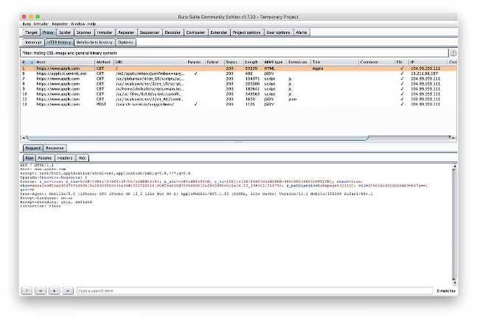


Exploiting Identified Vulnerabilities
Vulnerability Confirmation
Verify the existence and impact of identified vulnerabilities through proof-of-concept exploits.
Attack Automation
Leverage Burp's Intruder module to automate and customize attacks for further exploitation.
Privilege Escalation
Explore ways to elevate the level of access or control gained through the initial vulnerability.

Slide 7


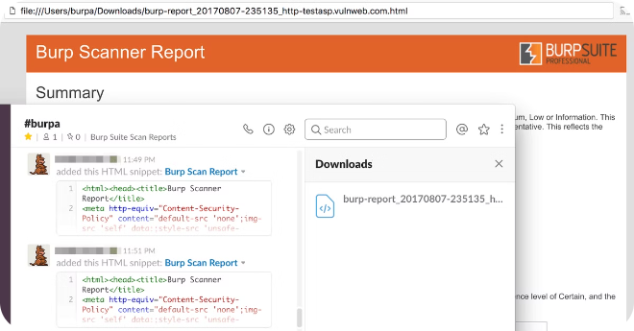


Reporting and Documenting Findings
Comprehensive Report
Generate a detailed report outlining the discovered vulnerabilities, their impact, and recommendations for remediation.
Evidence Documentation
Capture and include relevant evidence, such as screenshots, request/response data, and exploit details, to support findings.
Presentation Preparation
Prepare a clear and concise presentation to effectively communicate the assessment results to stakeholders.

Slide 8

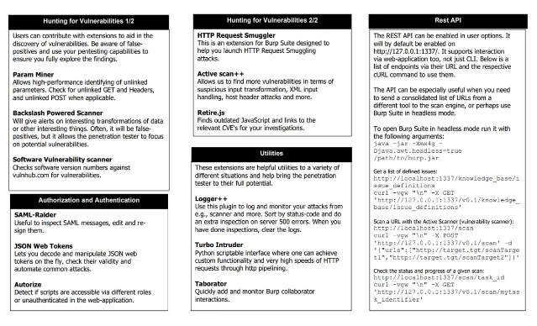
Conclusion and Next Steps
Burp Suite is a powerful tool that can greatly enhance your website investigation capabilities. By mastering its features and techniques, you can effectively identify, exploit, and report on vulnerabilities to improve the security of your target websites.

